Slide 1
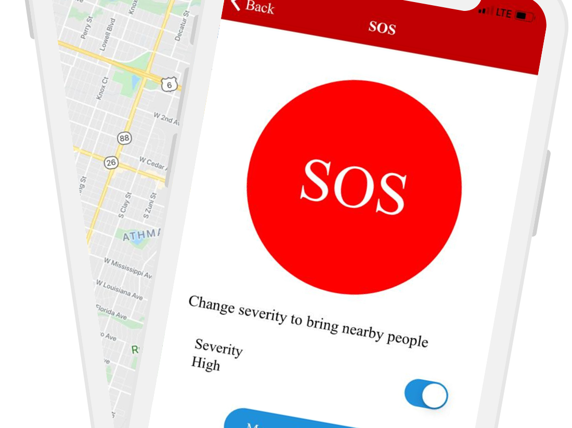
SOS app to connect the patient/victim with nearby doctor as well as 112 Emergency service.
The Nearby Doctors attends to the patient/victim during golden hour need of medical support thru GPS/GIS app with navigation, Live Streaming / Video Conference app, TPA App, Healthcare Database App, Payment Gateway App, Etc.

Slide 2
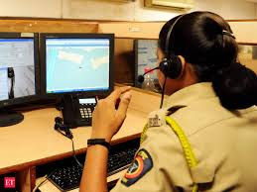
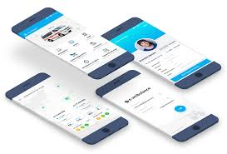
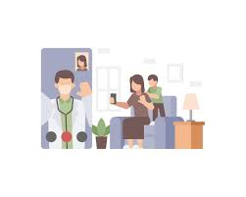
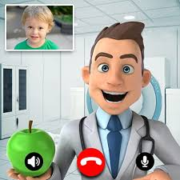
Patient / Victim presses the SOS button on app
The app connects the Audio/Video Conference call to the 112 emergency service centre, Close Relatives / pre-defined emergency contacts, searches for the nearby available Doctor and connects him/her .

Slide 3
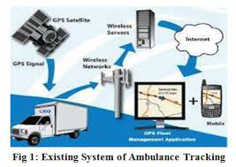
112 Emergency traces the victim’s location and Ambulance deployed.
The 112 emergency service traces the location of the victim thru GPS/GIS location tracking as well as Cellular tower triangulation. The nearby stationed /available Ambulance is deployed to the accident/incident spot.

Slide 4
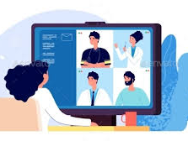
The SOS app connects all the five on Video Conference
The SOS app simultaneously traces/tracks the nearby Doctor and subsequent to his/her acceptance to attend the patient all the five (patient/nearby Doctor/112/ambulance/Patient’s Close relative) are connected to Live Streaming / Video Conference call.

Slide 5
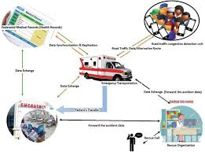
The patient medical History is fetched from database
The patient medical history is fetched from cloud database and made available to the attending Doctor, Ambulance Medical Attendant and the Trauma care Hospital which accepts the patient’s admission.

Slide 6

The TPA empanelled hospital is connected in the loop.
The TPA (Health Insurance) card ID is integrated and the empanelled trauma care hospitals nearby are sent SOS message. Which ever member hospital accepts the patient is connected in the conference and patient medical history is shared with them from the cloud data.

Slide 7
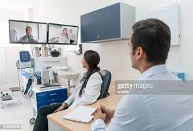
The trauma care hospital gets ready for the patient
The TPA member trauma care hospital gets ready based on the medical history details and the attending Doctor’s input - to treat the patient well ahead of his/her arrival at the premises.

Slide 8
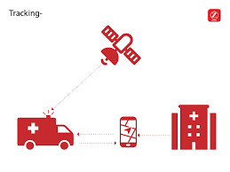
The Close Relatives tracks the events live
The close relatives/emergency contacts are constantly connected and updated live. They track the entire process (The Attending Doctor, 112 emergency process, the trauma care hospital and the ambulance) live and gets the payment gateway link to pay for the attending doctor fees and trauma care hospital admission advance.

Slide 9
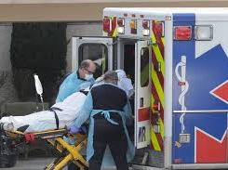
The patient is taken to pre-identified TPA hospital
The patient is taken to the TPA approved nearest trauma care centre for further treatment.

Slide 10
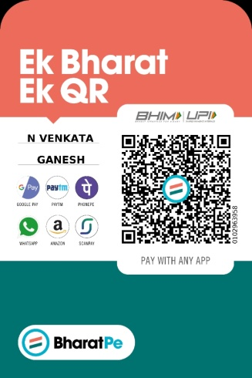
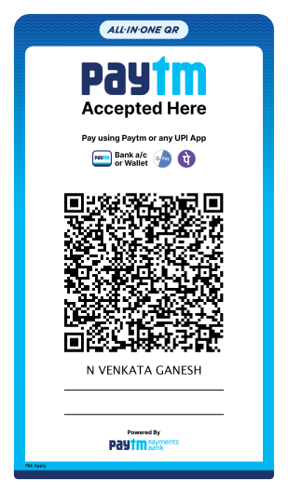



Payment gateway integration at all stages of the app
Right from the registration/Sign up of Doctors, Consumer/Patient/victim,
TPA Empanelled Hospitals the Payment Gateway is linked for them to get the membership and also to receive the payment from the patient/the relatives.

